Slide 1

Knowledge Editing Comparison
Matthew Hutchinson, Corey Shen, Nathan Wei
CS 263 Final Project
Notes:
Our project evaluates knowledge editing methods. The main question is: when a model appears to learn an edited fact, does that edit behave consistently beyond the exact rewrite prompt?

Slide 2
Direct Edits Show a Tradeoff
CounterFact: rewrite accuracy vs. locality
IKE is near-perfect on direct rewrite, but its locality collapses; ROME gives the strongest balance.
CounterFact-original, n=300
Rewrite
Locality
1.0
0.993
0.983
0.980
1.000
0.840
0.780
0.743
0.5
0.387
0.067
0.0
ROME
MEMIT
IKE k=8
Takeaway: IKE wins rewrite, but locality reveals preservation damage.
Notes:
We first looked at the standard CounterFact metrics like rewrite accuracy, rephrase accuracy, and locality.
The main pattern is that each method has a different tradeoff. IKE is very strong on rewrite and rephrase accuracy, but its locality is very low. ROME has stronger locality than IKE, but weaker rephrase performance. MEMIT preserves locality best, but has lower direct edit success in this setting.
So from the standard metrics alone, there is no clear winner. A method can look excellent on direct editing while still creating problems elsewhere.

Slide 3
What We Tested Beyond Rewrite
Direct success is necessary, but it is not the whole edit.
We separate three questions: does the target fact change, is unrelated behavior preserved, and do related consequences update?
Direct success
Specificity
Consistency
Does the edited prompt produce the new target?
Do unrelated prompts preserve the model's old behavior?
Do related consequences update after the edit?
>
>
rewrite / rephrase
CounterFact locality
probes / MQuAKE / RippleEdits
Result: direct factual recall improves more reliably than inverse, multi-hop, or ripple consistency.
Notes:
That motivated the second part of our evaluation. Rewrite accuracy mostly asks whether the model can repeat the new fact directly.
We wanted to test whether the edit acts more like a coherent update. So we evaluated three dimensions: direct success, specificity, and consistency.
Consistency is the key addition here. It asks whether the edited fact transfers across inverse prompts, negation, compositional questions, contradictions, and reasoning-style probes.

Slide 4
Rewrite Success Is Not Logical Consistency
225-probe diagnostic set
Total probe scores stay below 0.43, and inverse transfer is the clearest failure mode.
Inverse transfer pass rate
40.0%
42.2%
37.8%
ROME
0.0%
ROME total pass
MEMIT total pass
IKE total pass
MEMIT
0.0%
IKE
8.9%
Hardest failure mode: edits often do not transfer from subject-to-object form into object-to-subject queries.
A model can learn to say the new fact without updating nearby consequences.
Qualitative example: after editing Sanofi headquarters from Paris to Berlin, a direct paraphrase can succeed while an inverse query like "Which company has its headquarters in Berlin?" still fails to return Sanofi.
Notes:
The diagnostic probes show that rewrite success does not imply logical consistency.
Across the full probe set, all three methods are only around 38 to 42 percent. So even when edits work directly, the surrounding behavior is often incomplete.
The biggest failure is inverse transfer. ROME and MEMIT are at zero percent, and IKE is still very low. That means the model often does not connect the edited fact in the reverse direction.
The probe-type results make this more precise. Models do better when the prompt gives them more support, but they struggle when the edit has to be used implicitly or from the target side.
So our takeaway is that current editing methods can change surface recall without fully updating the model’s related knowledge behavior.”
That’s the main-project result. From here, Corey will talk about applying this idea in a RAG setting.

Slide 5
ROME meets RAG
Existing knowledge-editing benchmarks mostly test whether the edited model remembers a new fact
Real systems often use RAG
Model sees retrieved documents at inference time.
Question:
If ROME changes internal knowledge, but retrieved context says the old fact, which source wins?
Example:
ROME edit: “The capital of the U.S. is Los Angeles.”
Retrieved context: “The capital of the U.S. is Washington, D.C.”
Query: “What is the capital of the U.S.?”

Slide 6
RAG Experimental Design
Evaluate each case in three conditions:
No RAG context: query the edited model directly
Consistent RAG context: retrieved text supports the ROME edit
Conflicting RAG context: retrieved text states the original fact
Takeaways:
The conflicting retrieved document did not clearly override the post-edit prompt instruction
The models often followed the provided retrieved context over the knowledge edit when the two conflicted

Slide 7
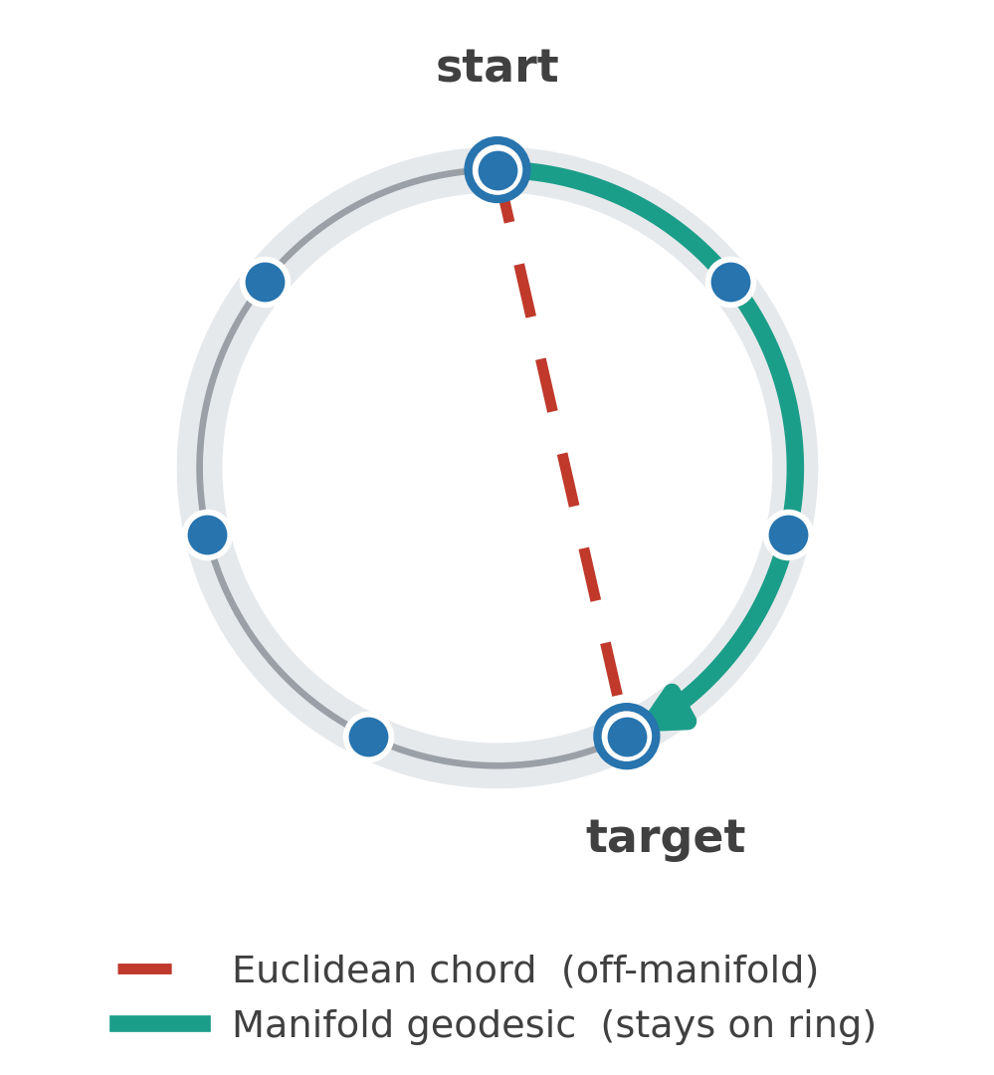
From Editing Facts to Steering Geometry
Newer methods intervene on how concepts are represented, not just what facts are stored
Knowledge editing: ROME/MEMIT/IKE
Surgically overwrites one fact in the weights or context. But edits stay shallow, inverse-query transfer ~0 %, conflicting RAG can override the edit, i.e. the internal representation stays in a black box
Geometry aware steering
Concepts live on low-dimensional manifolds. Steer along the manifold, not a straight Euclidean line that cuts off-manifold and garbles the output. We want the right geometry no the right direction
Euclidean chord cuts off-manifold; the geodesic follows the ring.
Our work: is concept geometry shared across languages? We test whether days (cyclic) and years (linear) are cross-lingually readable and steerable in a multilingual LLM, specifically between English and Chinese
Notes:
So far we’ve treated knowledge editing as surgery — ROME, MEMIT, and IKE overwrite a specific fact in the weights or the context. And we just saw the limitations: the edits don’t transfer to inverse queries and a conflicting retrieved document may override the edit. A newer line of work focuses on geometry and flips that around. It starts from HOW concepts are laid out: on low-dimensional, curved manifolds. And it shows that if you want to steer a model, you should move along that manifold rather than taking a straight Euclidean line that cuts off-manifold and garbles the output. We should focus on the right geometry, not the right direction. That’s the picture on the right the dashed chord cuts across, the green path follows the ring. For our task, we asks whether that shared geometry holds across languages.

Slide 8
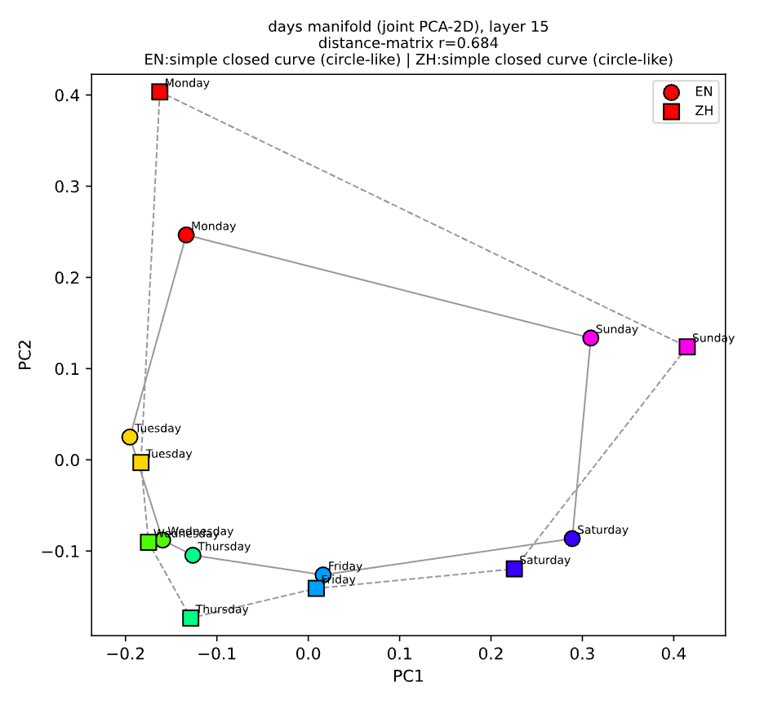
Readable, Usable, Steerable
Cross-lingual concept geometry, read out and causally used across English ↔ Chinese (Qwen2.5-7B)
Readable
Usable
Steerable
A probe trained in one language reads the concept off the other, and it strengthens with scale.
A steering vector built in one language causally moves behavior in the other.
A norm-preserving, on-manifold (spherical) intervention beats naive additive steering.
years r ~ 0.99 days up to 0.85
clean for years (linear)
days ZH→EN: 2.24 vs 0.58
cross-lingual RSA saturates (random nouns r ≈ 0.47) -> magnitude ≠ shared manifold.
Fragile for days (cyclic): it steers, then fluency collapses outside a narrow window.
Next: adopt the newer interpretability methods
Replace RSA with explicitly fitted manifolds, an activation manifold (Mₕ) and a behavior manifold (Mᵧ), and test cross-lingual geodesic isometry vs. a chord + shuffled null.
Upgrade steering to true geodesics on the manifold, judged by a naturalness metric (distance of the behavior trajectory to Mᵧ), not “off-target broke.”
Notes:
We test three things in Qwen, across English and Chinese.
Readable: if the model forms a concept in English, can we read it out of its Chinese activations? We train a probe in one language and test it on the other. Years transfer almost perfectly; days are still strong — about 0.85 correlation. And it improves with scale: the day metric gets better from the 1.7-billion model to the 7-billion one.
Usable: can we act on that shared picture? A steering vector built in one language nudges behavior in the other — cleanly for years, which is basically a straight line. Days live on a ring, so a straight push steers the answer but breaks fluency.
Steerable fixes that: instead of pushing in a straight line, we rotate along the ring. Those two numbers — 2.24 versus 0.58 — are the strongest clean push each method manages before the output breaks. Rotating gets to 2.24 and stays fluent; plain addition stalls at 0.58. The takeaway is that it only works one direction.
Next, we swap RSA, which just approximates whether the two languages trace a similar shape, which turns out unreliable — for fitting the concept's actual curve in each language, and steering along those curves.

